Slide 1
Moore Family Heritage

Slide 2
Introduction
The mid 1800’s marked the origin of a unique family. Throughout the years, many have gone, but many, many more have come. All across this nation, from near and far, we’ve covered the land with our riches, seeds of courage, and multitudes of love.
This is an account of the Moore Family History. It covers many generations with the main focus being Eugene Moore, Sr. and his descendants. It was compiled from information obtained from family members, cemetery records, and census records. From these sources, an attempt has been made to build a comprehensive family story. We have used a portion of this compilation for this presentation.

Slide 3
Although we must live so far apart, we will always look forward to family reunions; a time when we can laugh about old fun times and talk about present and future times. Then, of course, we must be on our way, to the lifestyles we’ve established. But the legacy of our roots will continue forever.
It is my hope that this account will serve as a source of pride for all family members and that it will be a legacy for younger members as they pass on the torch of their own experiences and knowledge to the next generation.
Originally compiled in 1991 by Linda Blanton
Linda is the daughter of Eugene Moore, Jr. and died in January, 2017

Slide 4
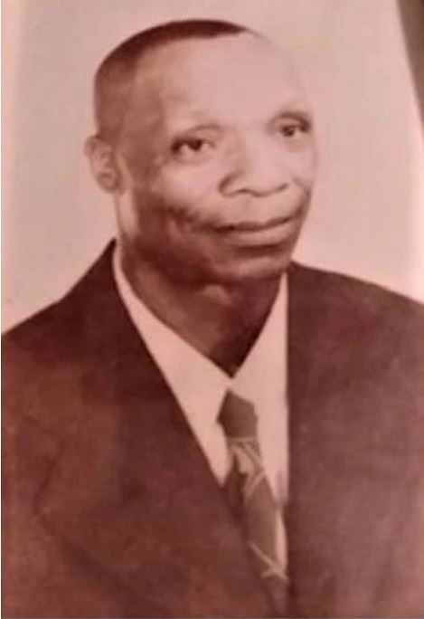

Slide 5
Origins of the Moore Family
The parents of Eugene Moore, Sr. were Nelson Moore and Carrie (Jones) Moore. Nelson was born in Alabama in October 1855 and Carrie was born in Arkansas in June 1861. They married around 1880 and settled in Spring Creek, Arkansas. They had 15 children. Eugene was number 6. Eugene was born December 9, 1890. He died on December 10, 1964. This presentation is the lineage of his family.
Alabama
Arkansas

Slide 6
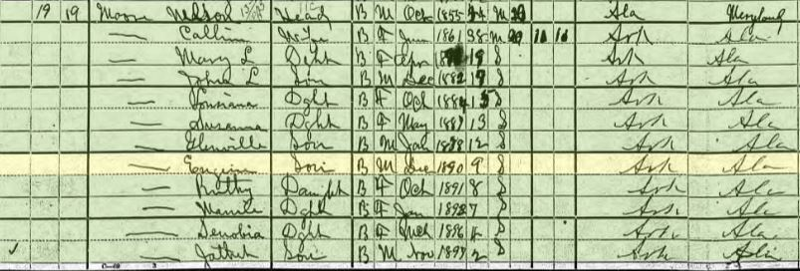
1900 Census

Slide 7
Eugene Moore, Sr. moved to Brighton, TN where he was sharecropper in an area known as “The Bottom”.

Slide 8
Brighton, Tennessee
Eugene, Jr’s Home
Eugene, Sr’s Home

Slide 9
Family Farm of Eugene Moore, Jr.

Slide 10
Eugene Moore, Sr. & Rosetta Mckenzie Married November 1, 1912
Nina Juanita (2 Children)
Born March 31, 1912
Ellihue (7 Children)
Born November 26, 1913
Louisa Lodora (1 Child)
Born March 4, 1916
Tomie Geneva (1 Child)
Born March 31, 1919
Eva Louise (4 Children)
Born July 3, 1921
Rosetta (died as a baby)
January 27, 1926

Slide 11
Eugene Moore, Sr Eliza Fields Married April 24, 1926
Eugene, Jr. (7 Children)
Born Dec 10, 1926
Dorothy Mae (died as a baby)
Born June 23, 1928
Nelson Beverly (3 Children)
Born May 18, 1930
Ever Jean (2 Children)
Born March 8, 1933
Ester Mae (died as a baby)
Born June 13, 1935
Walter Lee
Born June 22, 1936
William Arthur (died as a baby)
Born February 6, 1939
Thomas Edward (died as a baby)
November 28, 1940

Slide 12
Eugene Moore, Sr. Eliza Fields Married April 24, 1926
Cora Ester (6 Children)
Born January 30, 1942
Robert Lee (6 Children)
Born January 13, 1944
Lorraine (2 Children)
Born December 3, 1945
Napoleon (2 Children)
Born May 2, 1948
Laurence Wayne (4 Children)
Born May 24, 1950

Slide 13
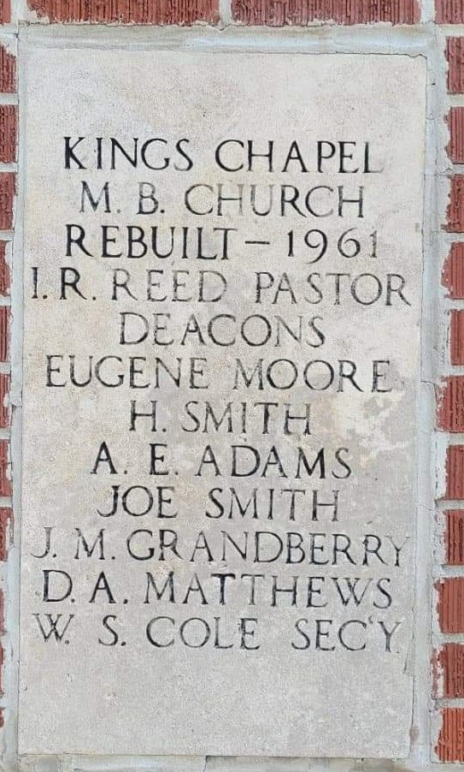
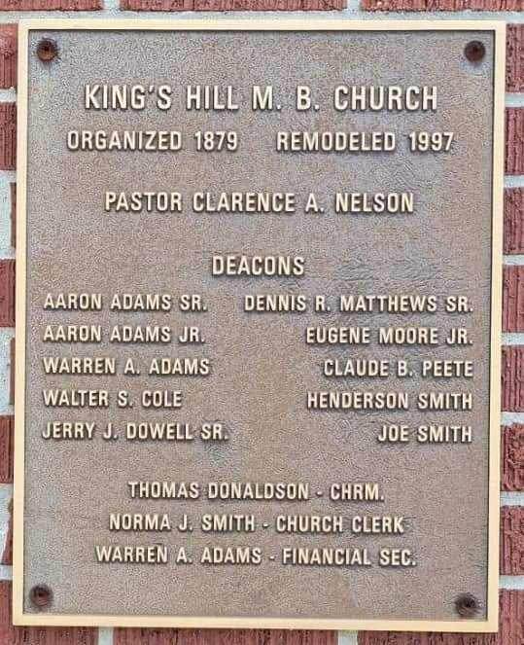
Eugene Moore, Sr.’s Faith
Eugene Moore, Sr was an avid prayer. He was a Sunday School teacher and a deacon at King’s Hill Missionary Baptist Church in Covington, TN and his name is engraved on the cornerstone as a founding member.
Eugene Moore Jr was also a Deacon at Kings Chapel M.B. Church

Slide 14
A Poem of Gratitude read by Matthew McCollum
Some people wonder about their heritage
Who they are and where they’ve been
This Family Tree will tell us all
From our very start to the end

Slide 15
It reveals our ancestors and descendants
And all in between
Including those just beginning
To come into the scene.
As we continue this journey
Sharing our joys and sorrows
We’ll Always remember our beginning
And prepare for a prosperous tomorrow
Finally, we won’t have to say “Who’s That?”
And wonder just the same
So Thanks to all who contributed
To gathering all these names.

